Slide 2
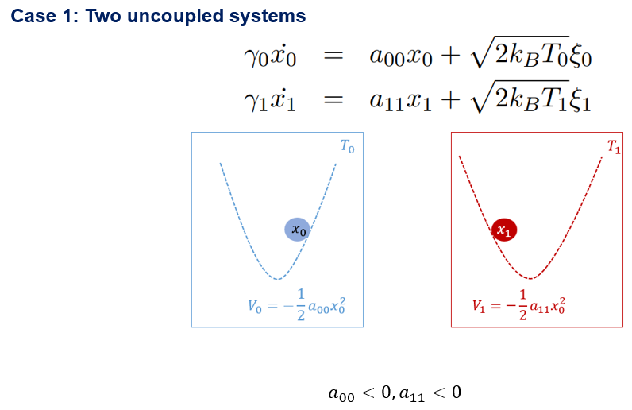

Slide 3
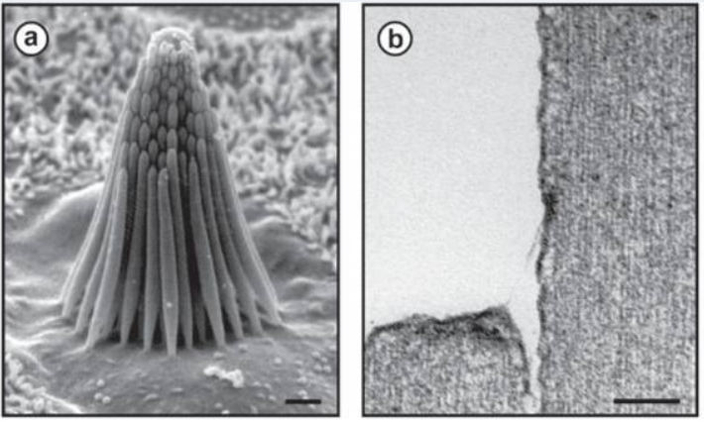
https://www.ncbi.nlm.nih.gov/pmc/articles/PMC2865174/

Slide 4
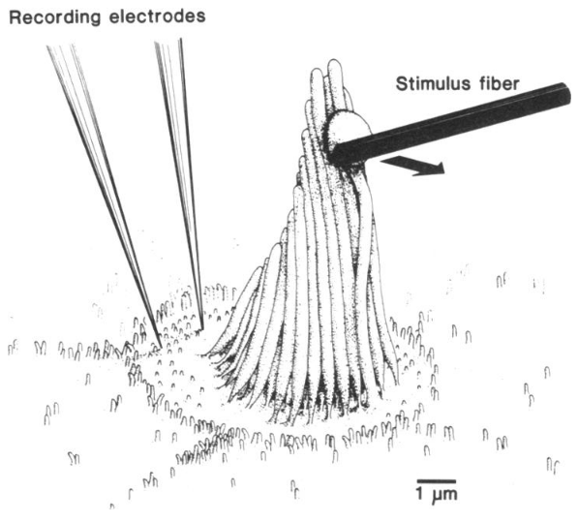
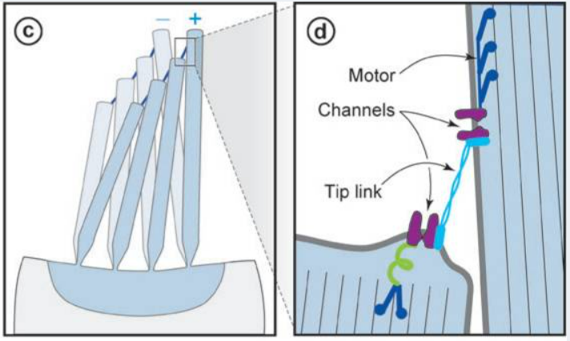
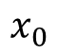
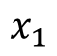
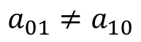
Hair bundle oscillations
a
b
c
d
$$x_{0}$$
$$x_{1}$$
$$a_{01}≠a_{10}$$

Slide 5



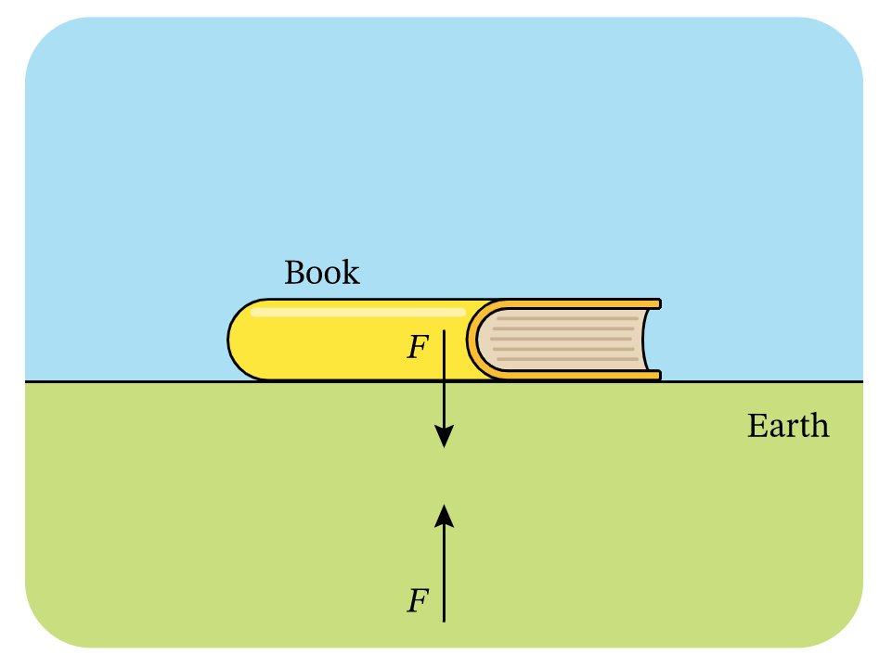







Equilibrium system
Non-equilibrium system
No net flow of matter
and energy
Continuous consumption and
dissipation of energy
(a)
heat flow
$$T_{h}$$
$$T_{c}$$
(b)
$$T_{f}$$
$$T_{f}$$
Reciprocal interaction
$$action =reaction$$
book
$$F$$
Earth
$$F$$

Slide 6





(a)
Reciprocal interaction
(b)
$$action =reaction$$
book
$$F$$
Earth
Non-reciprocal interaction
$$F$$
$$action ≠reaction$$

Slide 7
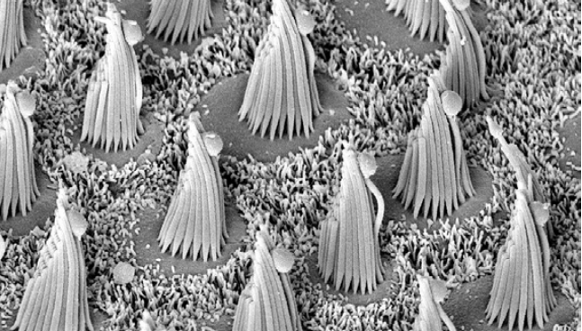

(a) Hair bundle
Non-reciprocal interactions
$$action ≠reaction$$

Slide 8
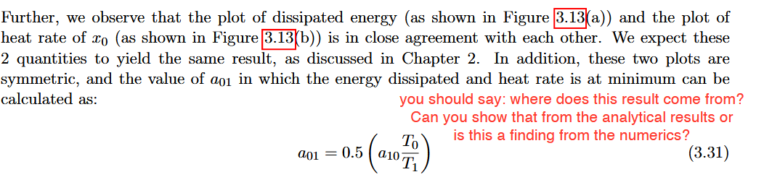
When we vary a_01 from 0 to -0.5 (with a_10 = -0.5), we expect that the value of heat rate and J are 0 at a_01 = 0 (because this is uncoupled - equilibrium) and a_01 = -0.5 (reciprocal interaction – equilibrium). With this intuition, then the values of heat rate and J from -0.5 < a_01 < 0 should have a parabolic shape. And this is what we have observed from the plot. That’s the idea I have for this

Slide 9
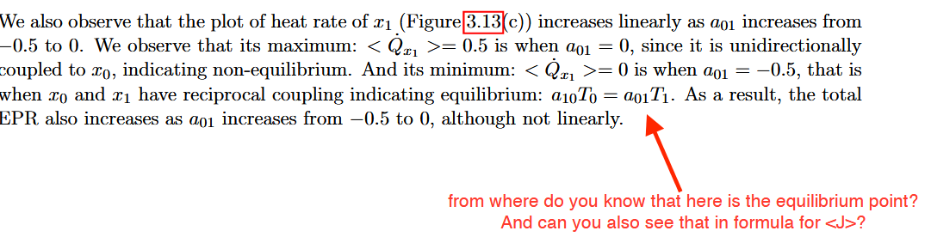
When a_01 = a_10 we have reciprocal coupling and it is in equilibrium. FDT also holds when a_10*T_0 = a_01*T_1. From your paper you mentioned that this can be derived from detailed balance and from the FDT but I was not able to understand mathematically why we can also derive it from FDT.

Slide 10
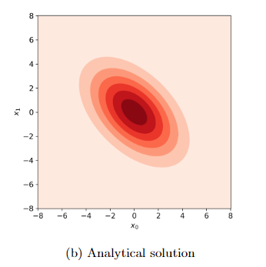
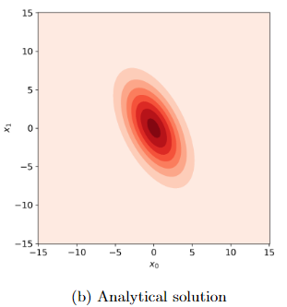
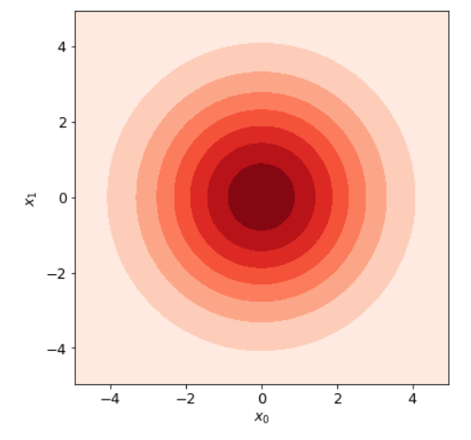
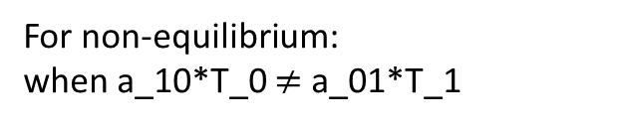
1. Joint PDFs
My results are:
For equilibrium:
when a_10*T_0 = a_01*T_1
For non-equilibrium:
when a_10*T_0 $≠$ a_01*T_1
I have observed that both plots show that they x_0 and x_1 are negatively correlated, but with the equilibrium case showing a weaker correlation than the non-equilibrium case. Is this correct?
I wanted to ask if I should also plot this? I get this plot when I set a_01 = a_10 = 0, in this case x_0 and x_1 are uncoupled and so they are not correlated at all

Slide 11
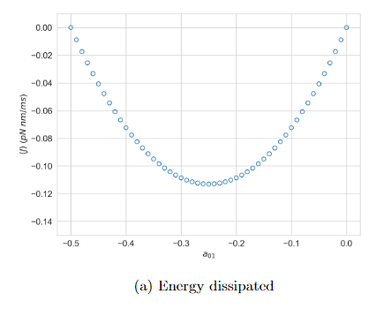
2. Estimated energy from violation of FDT
From Berger’s paper: <J> = 5.09 pN nm/ms – the value is positive. Does this mean that the energy is flowing from the heat bath to the particle? Can I say that in this case, the particle is extracting or using energy from the surrounding environment?
And this is the opposite for the different degrees of reciprocity result, where values of <J> are negative. In this case, the particle is dissipating energy, and so the energy is flowing from the particle to heat bath.

Slide 12
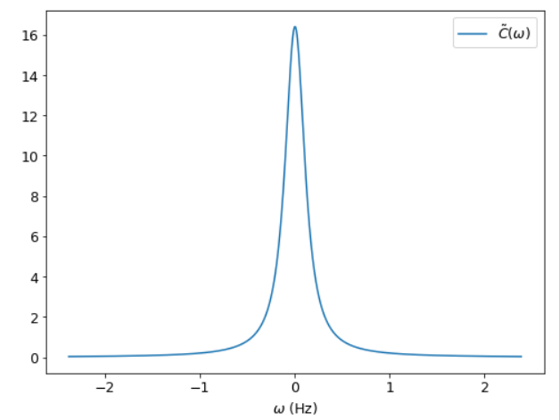
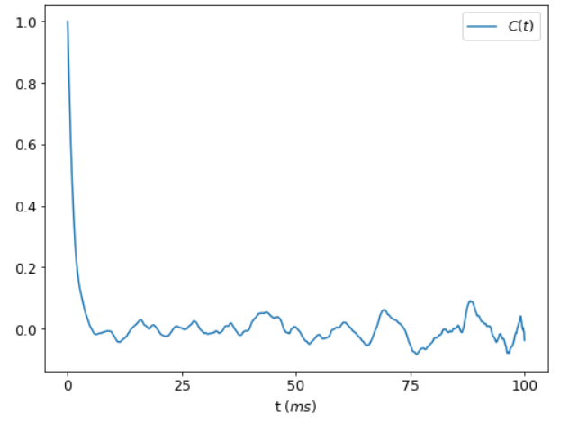
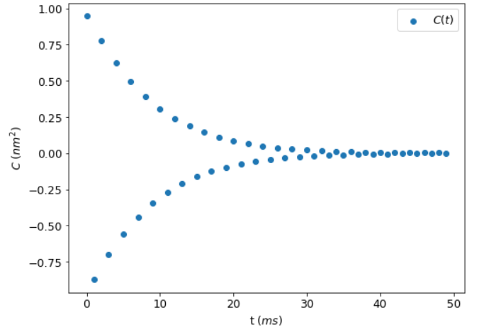
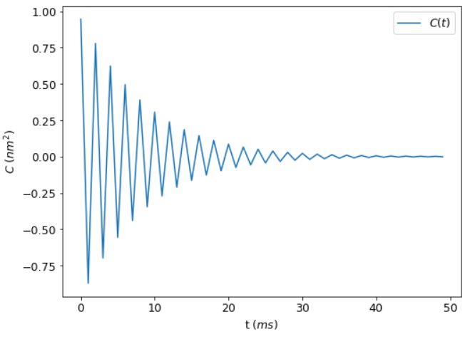
3. Cellular sensor: Autocorrelation
Autocorrelation (analytical solution)
Autocorrelation function $\left\langle X\left(t\right)X(t+tau)\right\rangle$ using Euler
Inverse Fourier Transform of Autocorrelation (analytical solution)
Parameters: a_00 = a_11 = -1
a_01 = 1
a_10 = 0
T = 100ms
Delta_t = 0.001ms
Using plt.scatter()
Using plt.plot()

Slide 13
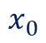
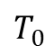
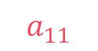
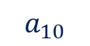
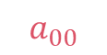
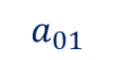
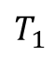
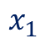
$$a_{00}$$
$$a_{11}$$
$$a_{10}$$
$$T_{0}$$
$$x_{0}$$
$$x_{1}$$
$$T_{1}$$
$$a_{01}$$

Slide 14
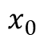
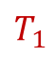
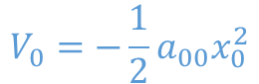
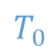

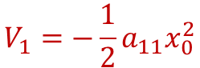
$$T_{0}$$
$$T_{1}$$
$$x_{0}$$
$$x_{1}$$
$$V_{0}=−\frac{1}{2}a_{00}x_{0}^{2}$$
$$V_{1}=−\frac{1}{2}a_{11}x_{0}^{2}$$

Slide 15
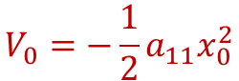
$$T_{0}$$
$$T_{1}$$
$$x_{0}$$
$$x_{1}$$
$$V_{0}=−\frac{1}{2}a_{00}x_{0}^{2}$$
$$V_{0}=−\frac{1}{2}a_{11}x_{0}^{2}$$

Slide 16
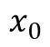
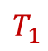

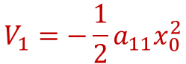
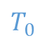
$$T_{0}$$
$$T_{1}$$
$$x_{0}$$
$$x_{1}$$
$$V_{0}=−\frac{1}{2}a_{00}x_{0}^{2}$$
$$V_{1}=−\frac{1}{2}a_{11}x_{0}^{2}$$

Slide 17
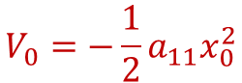
$$T_{0}$$
$$T_{1}$$
$$x_{0}$$
$$x_{1}$$
$$V_{0}=−\frac{1}{2}a_{00}x_{0}^{2}$$
$$V_{0}=−\frac{1}{2}a_{11}x_{0}^{2}$$

Slide 18

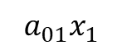
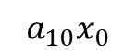
$$T_{0}$$
$$T_{1}$$
$$x_{0}$$
$$x_{1}$$
$$a_{01}x_{1}$$
$$a_{10}x_{0}$$
$$V_{0}=−\frac{1}{2}a_{00}x_{0}^{2}$$
$$V_{0}=−\frac{1}{2}a_{11}x_{0}^{2}$$

Slide 19
$$x_{0}$$
$$V_{0}=−\frac{1}{2}a_{00}x_{0}^{2}$$

Slide 20
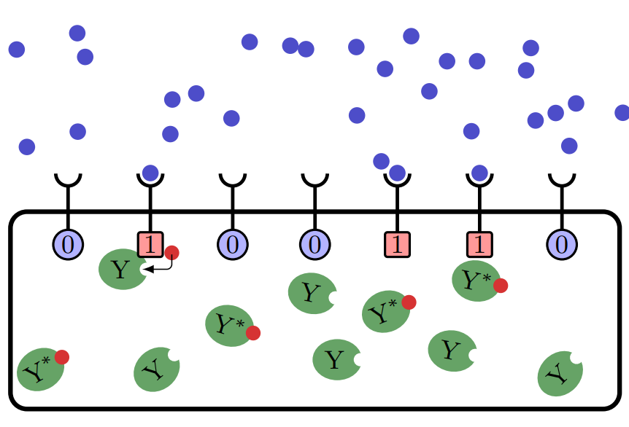
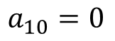
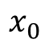
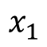
(a) Hair bundle oscillations
(b) Cellular sensor
$$x_{0}$$
$$x_{1}$$
$$x_{0}$$
$$x_{1}$$
$$a_{01}≠a_{10}$$
$$a_{10}=0$$

Slide 21
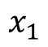
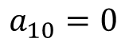
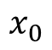
Cellular sensor
$$x_{0}$$
$$x_{1}$$
$$a_{10}=0$$

Slide 22
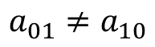
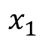




(a) Hair bundle
(b) Cellular sensor
1
2
3
$$x_{0}$$
$$x_{1}$$
$$x_{0}$$
$$x_{1}$$
$$a_{01}≠a_{10}$$
$$a_{10}=0$$

Slide 23

(a) Hair bundle
(b) Cellular sensor
(c) Deflection of hair bundle. Stereocilia tips remain in contact but shear with deflection. (d) Schematic model of transduction. Shearing with positive deflection increases tension in tip links, which pull open a transduction channel at each end. Myosin motors slip or climb to restore resting tension. An elastic gating spring likely exists between a channel and the actin cytoskeleton.
Hair bundle in a bullfrog saccule, comprising ~60 stereocilia and a single kinocilium (adjacent to tallest stereocilia) (scale bar = 1 μm). (b) Two stereocilia and the tip link extending between them (scale bar = 0.1 μm)

Slide 24
(a) Hair bundle oscillations
(b) Cellular sensor
(c) Deflection of hair bundle. Stereocilia tips remain in contact but shear with deflection. (d) Schematic model of transduction. Shearing with positive deflection increases tension in tip links, which pull open a transduction channel at each end. Myosin motors slip or climb to restore resting tension. An elastic gating spring likely exists between a channel and the actin cytoskeleton.
Hair bundle in a bullfrog saccule, comprising ~60 stereocilia and a single kinocilium (adjacent to tallest stereocilia) (scale bar = 1 μm). (b) Two stereocilia and the tip link extending between them (scale bar = 0.1 μm)

Slide 26
(a) Hair bundle
(b) Cellular sensor
(c) Deflection of hair bundle. Stereocilia tips remain in contact but shear with deflection. (d) Schematic model of transduction. Shearing with positive deflection increases tension in tip links, which pull open a transduction channel at each end. Myosin motors slip or climb to restore resting tension. An elastic gating spring likely exists between a channel and the actin cytoskeleton.
Hair bundle in a bullfrog saccule, comprising ~60 stereocilia and a single kinocilium (adjacent to tallest stereocilia) (scale bar = 1 μm). (b) Two stereocilia and the tip link extending between them (scale bar = 0.1 μm)

Slide 27


Different degrees of reciprocity
Parameters: T0 = T1 = 300
a10 = -0.5
a01 varies from 0, -0.01, -0.02, …, -0.49, -0.5
Energy dissipated
Stochastic heat for x
Computed from trajectories with t = 500ms, with delta_t = 0.01, averaged over 100 realizations. Take the slope. Plot (-1)*slope list to match dissipated energy

Slide 28

Different degrees of reciprocity
Parameters: T0 = T1 = 300
a10 = -0.5
a01 varies from 0, -0.01, -0.02, …, -0.49, -0.5
Stochastic heat for x
Stochastic heat for F
Computed from trajectories with t = 500ms, with delta_t = 0.01, averaged over 100 realizations. Take the slope. Plot (-1)*slope list to match dissipated energy

Slide 29


Parameters: T0 = 300 K
a10 = -0.5
a01 varies from 0, -0.01, -0.02, …, -0.49, -0.5 T1 changes from 200, 250, 300, 350, 400
Need to change x ticks to negative values
Energy dissipated
Stochastic heat
Computed from trajectories with t = 500ms, with delta_t = 0.01, averaged over 100 realizations. Take the slope.

Slide 30


Different degrees of reciprocity
Different degrees of reciprocity
Parameters: T0 = T1 = 300
a10 = 0.5
a01 varies from 0 to 0.5
Parameters: T0 = T1 = 300
a10 = 0.5
a01 varies from 0 to 0.5
Energy dissipated
Stochastic heat
Computed from trajectories with t = 500ms, with delta_t = 0.01, averaged over 100 realizations. Take the slope.

Slide 31



Cell sensor paper
Since we are going to study r and not x, I wrote my equations like this so I do not need to change the code
With the following parameters

Slide 32


Sample trajectories of r
Corresponding autocorrelation

Slide 33


Autocorrelation function
Response function

Slide 34


Stochastic heat:
r (sensor) = 0.52
x (signal) = 8.42e-5
Dissipated energy: 0.39

Slide 35


Dissipation (equation 17 in paper) = answer: $5.093∙{10}^{−18}$ Nm/s
1. Units in N, m, s
I did not get the 5.093, but I got 4.54 which I think is close

Slide 36

Dissipation (using the analytical solution derived)
1. Units in N, m, s
I did not get the 5.093, but I got 4.62 which I think is also close to 5.093

Slide 37

Dissipation (using the analytical solution derived)
2. Units in pN, nm, ms
This one is similar with the result of the numerical simulation awhile ago, but with units now in pN, nm, ms. This is also close to the value in the paper.

Slide 38



Stochastic Heat (convention used) – units of parameters in pN, nm, ms

Slide 39




Version 1: Stochastic Heat
Plotting the uncoupled and nonreciprocal separately:
Using parameters in the paper in units pN, nm, ms (100 realizations)
Uncoupled: a01 = a10 = 0
Nonreciprocal: a01 = 1, a10 = -1.348

Slide 40




Version 2: Stochastic Heat
Plotting the uncoupled and nonreciprocal separately:
Uncoupled: a01 = a10 = 0 (since a00 and a11 have the same magnitude, their difference is not very large now?)
Using parameters in the paper in units pN, nm, ms (100 realizations)
And change magnitude of a11 to be the same as a00
Nonreciprocal: a01 = 1, a10 = -1.348

Slide 41




Stochastic Heat using my own parameters in units pN, nm, ms (100 realizations)
Plotting the uncoupled and nonreciprocal separately:
Uncoupled: a01 = a10 = 0 (does not oscillate around 0, but around 2. Is it possible because of the magnitude that I used are the same for all, like a00 = 1, and kBT = 4.1?)
Nonreciprocal: a01 = -0.5, a10 = -0.75

Slide 42


Different degrees of reciprocity (Stochastic heat)
a01 changes from 0, 0.01, 0.02, 0.03, …, 0.48, 0.49, 0.5 (51 datapoints) averaged over 100 realizations
Display a01 = 0, a10 = - 0.5 first:
1. Reciprocal: a01 = -0.5, a10 = -0.5
2. Uncoupled: a01 = 0, a10 = -0.5

Slide 43



Different degrees of reciprocity (Stochastic heat)
a01 changes from negative 0, 0.01, 0.02, 0.03, …, 0.48, 0.49, 0.5 (51 datapoints)
Loop over a01_list = [-0, -0.01,…,-0.49, -0.5]
Generate trajectories with 30,000 data points
Compute stochastic heat:
Take the cumulative stochastic heat
Take average over 100 realizations
Take the last element and save it to the qx_list
Plot a01_list vs qx_list
Results:
Other parameters: (with a10 = -0.5 always)

Slide 44



Different degrees of reciprocity (Energy dissipated)
a01 changes from negative 0, 0.01, 0.02, 0.03, …, 0.48, 0.49, 0.5 (51 datapoints)
Other parameters: (with a10 = -0.5 always)
2. Sample plot: a01 = -0.3, a10 = -0.5
(This one is different from what I have seen before, where the red plot has a higher value than the blue plot. From this, I am expecting that the value of energy dissipated is negative. Is this correct?)
1. Sample plot: a01 = 0, a10 = -0.5
3. Sample plot: a01 = -0.5, a10 = -0.5

Slide 45


Different degrees of reciprocity (Energy dissipated)
a01 changes from negative 0, 0.01, 0.02, 0.03, …, 0.48, 0.49, 0.5 (51 datapoints)
Other parameters: (with a10 = -0.5 always)
Steps:
Loop over a01_list = [-0, -0.01,…,-0.49, -0.5]
Solve for
3. Integrate over the interval shown in the plots in the earlier slide

Slide 46

Different degrees of reciprocity (Energy dissipated)
a01 changes from 0, 0.01, 0.02, 0.03, …, 0.48, 0.49, 0.5 (51 datapoints)
Loop over a01_list = [0, 0.01,…,0.49, 0.5]
Solve for
3. Integrate over minus inf to positive inf
Other parameters:

Slide 47




Analytical Solution
Non reciprocal system
Autocorrelation function
Response function
Log-log plot
Log-log plot

Slide 48

Dissipation (equation 17 in paper) = answer: $5.093$pN nm/ ms
2. Units in pN, nm, ms
This one is very far from what I want, I don’t know why it gives very weird values when the code is just the same as in number 1 but just in different units. But the numerical simulation in units pN, nm, ms in the next slide is correct.

Slide 49




Analytical Solution
Reciprocal system
Autocorrelation function
Response function
Log-log plot
Log-log plot

Slide 50



Simulation
delta_t = 0.01
time = 500
number of data points = 500*0.01 = 50000 data points
number of realizations = 50
units of parameters are in pN, nm, ms
Non reciprocal system
A sample trajectory
Autocorrelation function $\left\langle X\left(t\right)X(t+tau)\right\rangle$
Where the values of tau are = 1, 51, 101, …, 49951 (a total of 1000 data points) averaged over 50 realizations
50 trajectories
Unit of autocorrelation = nm^2, unit of time = ms?

Slide 51



Simulation
delta_t = 0.01
time = 500
number of data points = 500*0.01 = 50000 data points
number of realizations = 50
units of parameters are in pN, nm, ms
Reciprocal system
A sample trajectory
Autocorrelation function $\left\langle X\left(t\right)X(t+tau)\right\rangle$
Where the values of tau are = 1, 51, 101, …, 49951 (a total of 1000 data points) averaged over 50 realizations
50 trajectories

Slide 52


Method 1: PSD simulation (non-equilibrium)
Log-log

Slide 53



Method 1: Equilibrium
Log-log

Slide 54


Method 2: PSD simulation (non-equilibrium)

Slide 55


Method 2: Equilibrium

Slide 56





Analytical Solution (${\tilde{C}}^{"}(ω) vs\frac{2k_{B}T}{ω}{\tilde{R}}^{"}(ω)$)
Reciprocal system
Non-reciprocal system
For the reciprocal system, the two quantities are equal. For the nonreciprocal system, they are not equal, as expected.
For the non-reciprocal system in the log log plot, is this correct?
Log-log plot
Log-log plot

Slide 57


To get the energy dissipation I used the values from this plot:
Am I understanding correctly that taking the integral in equation 5 is taking the violation function*delta omega, and then taking the sum of all of these? Units that I used is pN, nm, ms

Slide 58



Cumulative Stochastic Heat
Where x0 = x, and x1 = F
To get the energy dissipated, take the slope of x?
Units that I used is pN, nm, ms

Slide 59


T eff / T
Non-equilibrium
Equilibrium

Slide 60


PSD simulation (code)
1. Divide trajectory into blocks (num of blocks is 10)
2. For each block (there are 5000 data points): apply fft, multiplied by its complex conjugate, divide by frequency squared, divide by total time of each block
3. Take average over all the blocks
4. Do this for all trajectories, take average afterwards

Slide 61

PSD simulation (code): apply the psd to all trajectories and take the average

Slide 62


PSD simulation (results)
Nonreciprocal system
Reciprocal system
The shapes are the same for both reciprocal and nonreciprocal system, should the function be changed when a nonreciprocal system is used? That is, FFT multiplied by its complex conjugate divided by frequency squared divided by total time for each block
I am also not sure what the x-axis should be, in here I used the default which is (1,2,3,…,N data points)
The values increases again towards the end, should this also be discarded? Only consider half of the data points?

Slide 63



Another thing that I tried is to use the autocorrelation function that I obtained earlier, and:
Nonreciprocal system
Apply fft to autocorrelation function, the values increase again towards the end
Apply fft to autocorrelation function, but only plot the first half of the datapoints
Apply fft to autocorrelation function multiplied by its complex conjugate, only plot the first half of the datapoints

Slide 64



Another thing that I tried is to use the autocorrelation function that I obtained earlier, and:
Reciprocal system
Apply fft to autocorrelation function, the values increase again towards the end
Apply fft to autocorrelation function, but only plot the first half of the datapoints
Apply fft to autocorrelation function multiplied by its complex conjugate, only plot the first half of the datapoints

Slide 65






From paper
Analytical solution
Analytical solution (log-log space)

Slide 66

Analytical solution
Inverse FFT

Slide 67




Analytical solution (no coupling, a01 = a10 = 0)
Log-log space
Should I plot negative values of omega?

Slide 68




Analytical solution (no coupling, a01 = a10 = 0)
Log-log space

Slide 69
Show simulation of autocorrelation function notebook

Slide 70
Questions

Slide 71






Plot autocorrelation function following Berger & Hudspeth’s paper:
Numerical simulation steps (top panel):
Generate trajectories using Euler’s method following the parameters in the paper.
Compute for C(t) = <X(t) X(t+tau)> and plot C(t)
Perform a Fast Fourier transform of C(t) to get C(omega) and plot C(omega)
Analytical calculation steps:
Plot C(omega) using the autocorrelation generic solution that was derived last time
Plot C(omega) in log-log plot
Perform an inverse Fast Fourier transform of C(omega) to get C(t)
A sample trajectory using Euler (delta_t = 0.0001, for 0.005 seconds since it takes a lot of time to run it, I will extend it for longer times next time)
Plot C(t), however, since 0.005 seconds was used, I guess this is not enough to see the oscillations around zero
Perform a Fast Fourier transform of C(t) to get C(omega)
Plot C(w) using the analytical equation that I derived last week, following the parameters found in the paper. However, the peak that is observed is not at w = 8, but around w = 45
Plot C(w) in log log plot
Performing an inverse fast Fourier transform of C(w), to get C(t)

Slide 72






Plot autocorrelation function when there is no coupling, where a01 = a10 = 0:
Numerical simulation steps (top panel):
Generate trajectories using Euler’s method: parameters (a00 = 1, gamma = 1)
Compute for C(t) = <X(t) X(t+tau)> and plot C(t)
Perform a Fast Fourier transform of C(t) to get C(omega) and plot C(omega)
Analytical calculation steps (bottom panel):
Plot C(omega) using the autocorrelation generic solution that was derived last time
Plot C(omega) in log-log plot
Perform an inverse Fast Fourier transform of C(omega) to get C(t)
A sample trajectory using Euler (delta_t = 0.01, for 500 seconds)
Plot C(t) (averaged over 10 realizations)
Perform a Fast Fourier transform of C(t) to get C(omega)
Plot C(w) using the generic solution that I derived last week
Plot C(w) in log log plot
Performing an inverse Fast Fourier transform of C(w), to get C(t). There are 55 data points so x-axis is until 55

Slide 73
Getting a trajectory for the Berger & Hudspeth’s paper takes a lot of time, because if I set delta_t = 0.01, the values for x becomes really big that Python can’t handle. That’s why I decided to use delta_t = 0.0001. Because of this, it takes a lot of time to run it.
I don’t know why using the analytical solution (using the generic solution that was derived), the peak that I get for C(w) is not at w = 8. I followed the parameters that was used but I get the peak at w = 45. I tried comparing this using the exact formula from the paper, but I get the exact same plot with the generic solution (with the peak at w = 45).
I am confused with the x-axis when I plot C(w), and when I go from the time domain to the frequency domain, or vice versa. I used numpy.fft.fft for FFT and numpy.fft.ifft for the Inverse FFT
Here are the links to the notebooks:
I am available for a meeting this week. Next week we will have our last exam on Wednesday, I will be able to work full time on the thesis after Wednesday next week.

Slide 74




C(w)
Performing an inverse fourier transform of C(w), I got C(t)
This is the code, and when I use all 100 datapoints
C(w) in log-log plot

Slide 75


The autocorrelation doesn't go to zero instead, this is what I found:

Slide 76



Trajectory (using Euler’s method)

Slide 77


Plotting the autocorrelation for the trajectory of x0

Slide 78






Slide 79



Generic solution that I was able to derive agrees with what I get from the paper (however the plots are not what I expect)

